Slide 1

I N D I A’ S A G R I C U L T U R A L
C R O P P R O D U C T I O N A N A L Y S I S ( 1 9 9 7 - 2 0 2 1 )

Slide 2
P R O J E C T D E S C R I P T I O N
This report delves into the captivating realm of India's agricultural cultivation, providing a comprehensive visual exploration of key aspects and trends in the agricultural sector. Through the visual representations, readers can gain valuable insights into crop production, seasonal variations, regional distribution, and overall production trends. These visualizations enable intuitive analysis, allowing stakeholder to uncover patterns, identify areas of growth or concern, and make data-driven decisions.
By harnessing the power of Tableau, this report not only presents the data in a visually appealing manner but also provides an interactive experience for readers to explore the intricacies of India's agricultural cultivation. To Extract the Insights from the data and put the data in the form of visualizations, Dashboards and Story we employed Tableau tool.

Slide 3
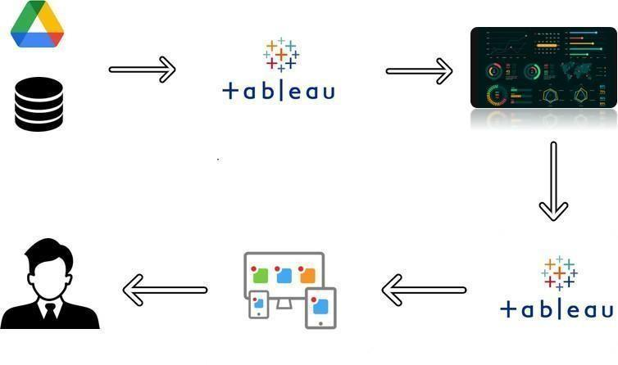
T E C H N I C A L A R C H I T E C T U R E

Slide 4

E M P A T H Y M A P
Says
What have we heard them say? What can we imagine them saying?
Thinks
What are their wants, needs, hopes, and dreams? What other thoughts might influence their behavior?
Agricultural work is very most beutiful work
Winter Corps:sown in winter-october to Decempar
Agricultural is most vailiable work form poovar pepoles
Agricultural can be alternative source of income for goans
Harvested in summar: April to june
important corps: Wheat,barly,mustard peas,gram,etc..
Agricultural encompasses crop and livestock production
India's Agricultural Crop
The india"s economy is mainly agricultural
:The sectore empolys 74.5% of the workforce
Agriculture was the key devalopment in the rice of sedentary human civilization
While humans started gathering grains at least 105,000 years ago
The root system of plants together with the fauna and microfauna in the subsoil ensure a stable nutrient balance
protection of the soil fertility in orter to recreate favorable and long-lasting nutural conditions
Does
What behavior have we observed? What can we imagine them doing?
Feels
What are their fears, frustrations, and anxieties? What other feelings might influence their behavior?

Slide 5


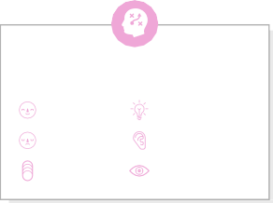



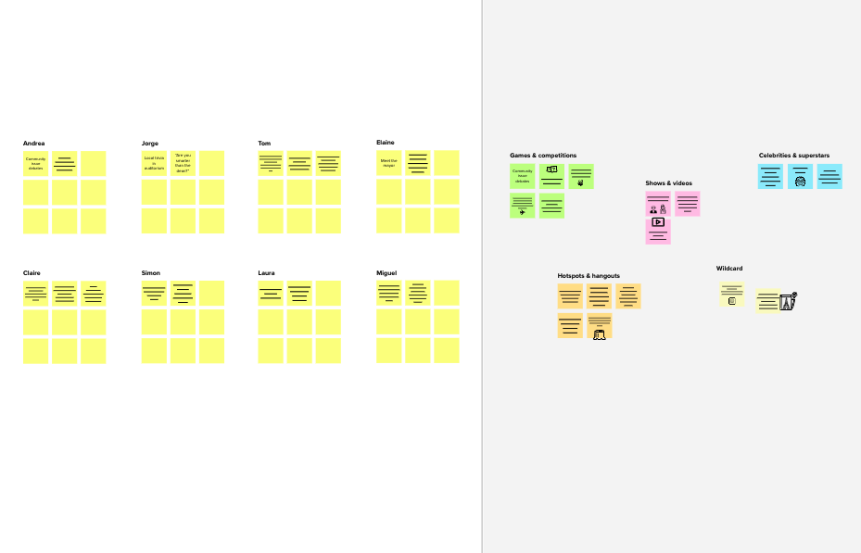
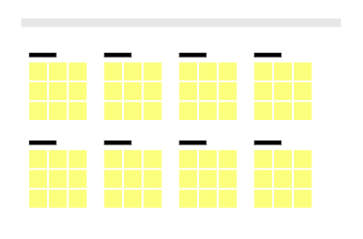
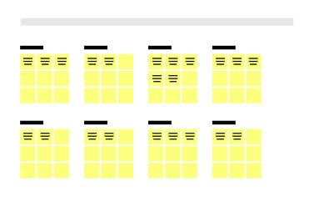
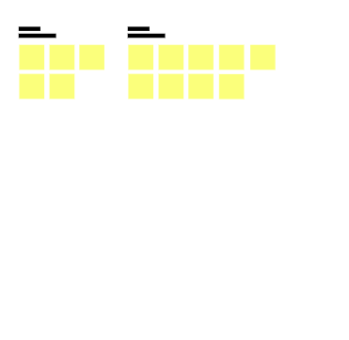
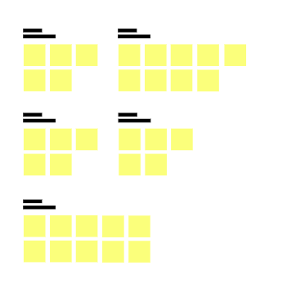
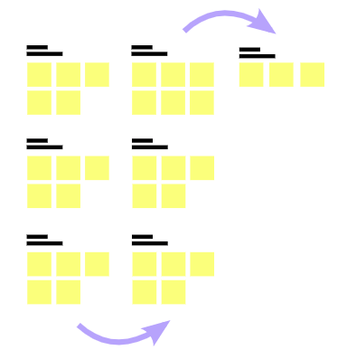
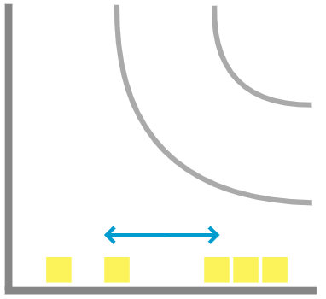
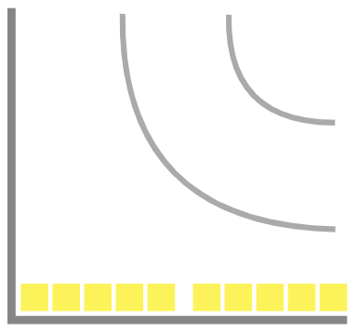
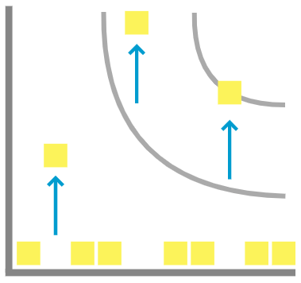
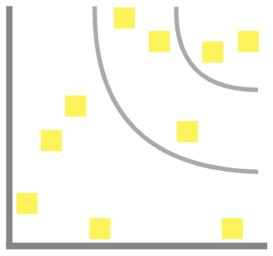

B R A I N S T O R M A N D I D E A P R I O T I Z A T I O N
Template
1
2
3
4
Before you collaborate
A little bit of preparation goes a long way with this session. Here’s what you need to do to get going.
10 minutes
Define your problem statement
What problem are you trying to solve? Frame your problem as a How Might We statement. This will be the focus of your brainstorm.
Brainstorm
Write down any ideas that come to mind that address your problem statement.
TIP
You can select a sticky note and hit the pencil [switch to sketch] icon to start drawing!
Group ideas
Take turns sharing your ideas while clustering similar or related notes as you go. Once all sticky notes have been grouped, give each cluster a sentence-like label. If a cluster is bigger than six sticky notes, try and see if you and break it up into smaller sub-groups.
TIP
Add customizable tags to sticky notes to make it easier to find, browse, organize, and categorize important ideas as themes within your mural.
Prioritize
Your team should all be on the same page about what's important moving forward. Place your ideas on this grid to determine which ideas are important and which are feasible.
TIP
Participants can use their cursors to point at where sticky notes should go on the grid. The facilitator can confirm the spot by using the laser pointer holding the H key on the keyboard.
After you collaborate
You can export the mural as an image or pdf to share with members of your company who might find it helpful.
5 minutes
10 minutes
20 minutes
20 minutes
Brainstorm
& idea prioritization
Use this template in your own brainstorming sessions so your team can unleash their imagination and start shaping concepts even if you're not sitting in the same room.
+
To analyze credit scores,income,employment history,debt-to-income ratios,and other financial factore to determine an individual's creditworthiness
Quick add-ons
_{A} Team gathering
Define who should participate in the session and send an invite. Share relevant information or pre-work ahead.
PROBLEM
Predicting prsonal loan approval using machine learning analyses a boorrwer's financial data and credit history to determine the likehoot of loan approval this can help financial institutions to make more informed decisons about which loan applications to approve and which to deny
Person 1
Person 2
Property documents should be a maximum considerable factore
Person 3
^{database} Salary certificate
^{schemas will} should be a
be constructed maximum
using the bank ^{considerable}
protocols ^{factore}
Person 4
Loan approvals has been done by both man and machine verification
AI Can be used to detect fraudulent loan applications
by analyzing data patterns and identifying anomalies
A ^{Share the mural}
Share a view link to the mural with stakeholders to keep
them in the loop about the outcomes of the session.
Security ^{Data has been}
Loan procedures has been collected by various financial institutuions
_{shoult get the} collected from
_{B} Set the goal
Think about the problem you'll be focusing on solving in the brainstorming session.
maximum priority
both bank officials and beneficiaries
To analyze credit scores,income,employment history,debt-to-income ratios,and other financial factore to determine an individual's creditworthiness
AI Can be used to detect fraudulent loan applications
by analyzing data patterns and identifying anomalies
B Export the mural
Export a copy of the mural as a PNG or PDF to attach to emails, include in slides, or save in your drive.
C
Learn how to use the facilitation tools
Use the Facilitation Superpowers to run a happy and productive session.
Loan procedures has been collected by various financial institutuions
10 minutes to prepare
1 hour to collaborate
2-8 people recommended
Open article
Person 5
Person 6
Person 7
Person 8
Keep moving forward
Strategy blueprint
Define the components of a new idea or strategy.
Open the template
Key rules of brainstorming
To run an smooth and productive session
Security shoult get the maximum priority
Stay in topic.
Encourage wild ideas.
Importance
If each of these tasks could get done without any difficulty or cost, which would have the most positive impact?
database schemas will be constructed using the bank protocols
Customer experience journey map
Understand customer needs, motivations, and obstacles for an experience.
Open the template
Defer judgment.
Listen to others.
Strengths, weaknesses, opportunities & threats
Identify strengths, weaknesses, opportunities, and threats (SWOT) to develop a plan.
Open the template
Go for volume.
If possible, be visual.
Share template feedback
-
-
Feasibility
Regardless of their importance, which tasks are more feasible than others? (Cost, time, effort, complexity, etc.)
+
Need some inspiration?
See a finished version of this template to kickstart your work.
Open example

Slide 6
We Created Dashboard, Story using Tableau and analysing Indians Agriculture Crop Production

Slide 7
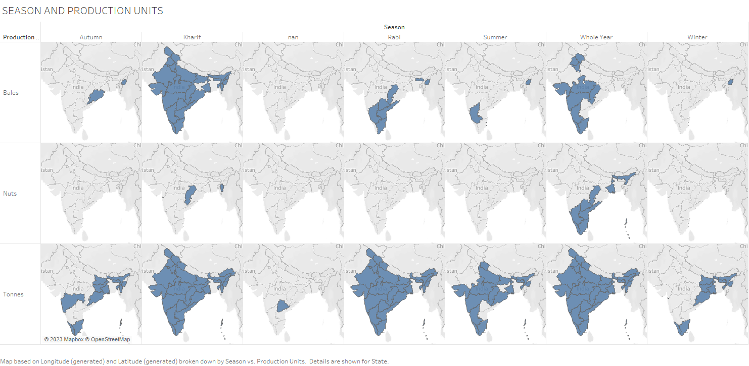

Slide 8
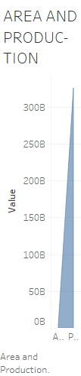
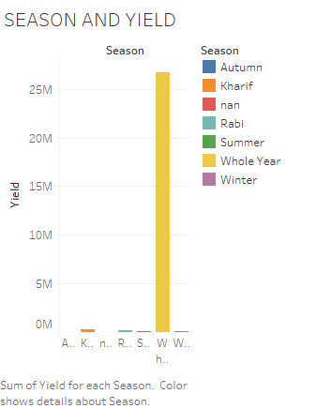

Slide 9
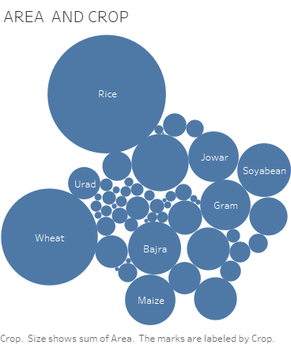

Slide 10
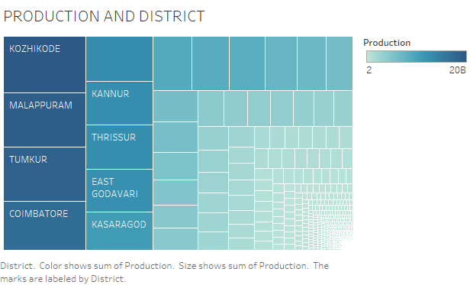

Slide 11
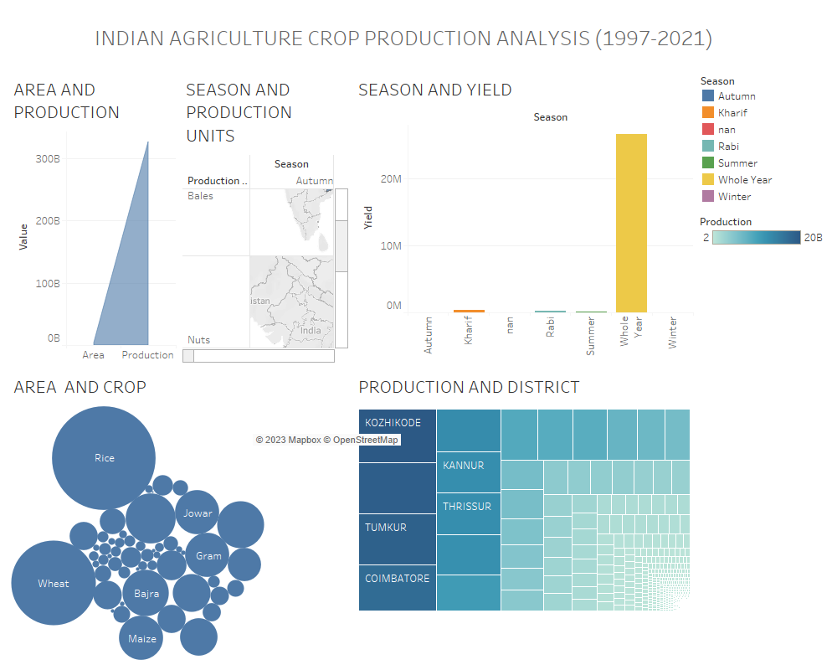

Slide 12
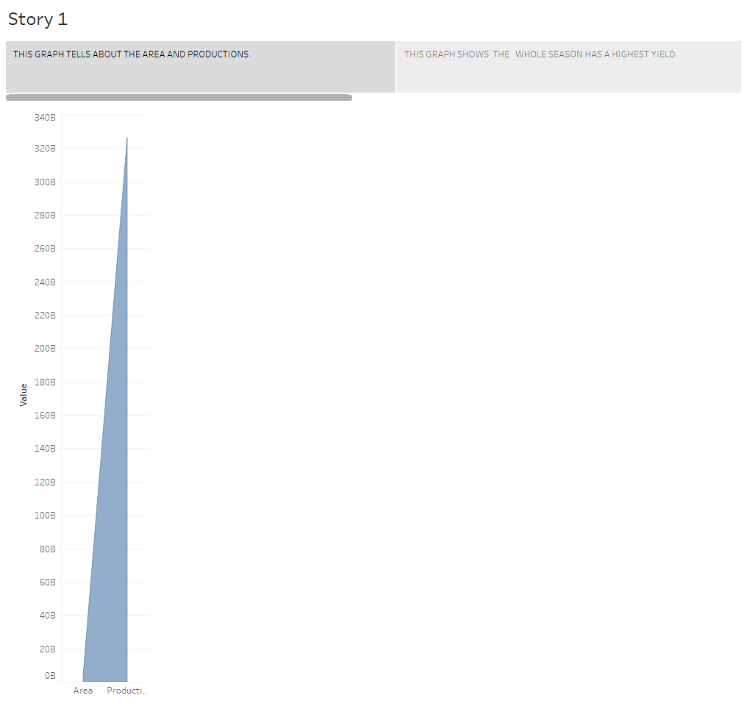
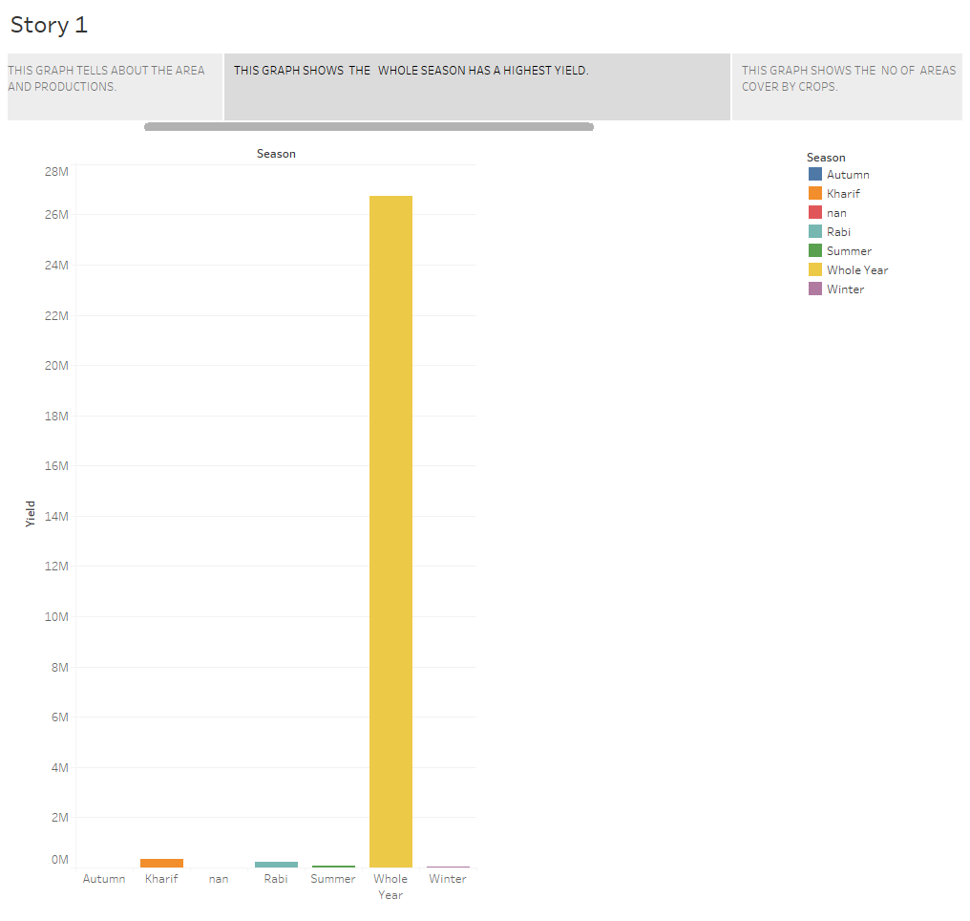
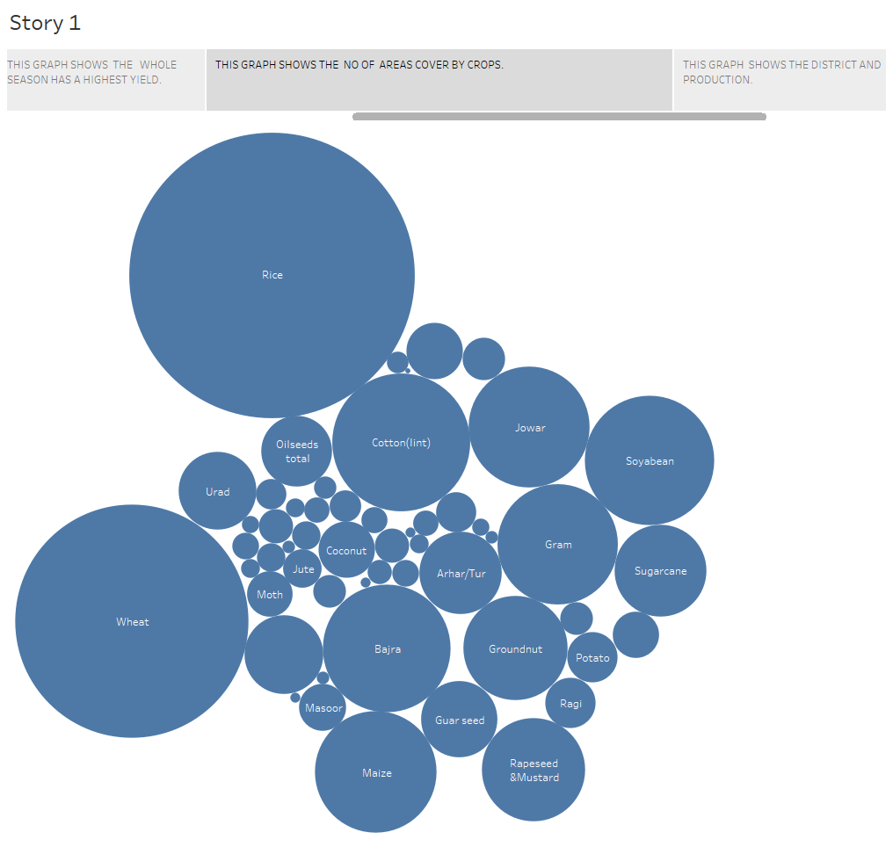
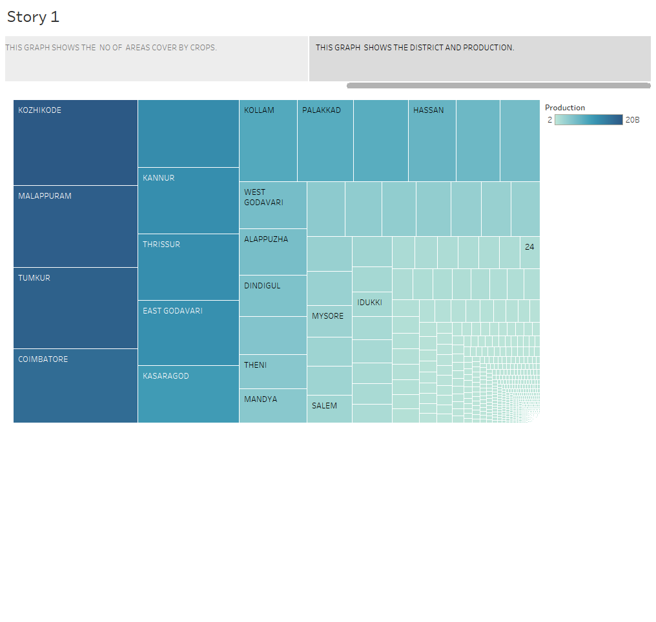
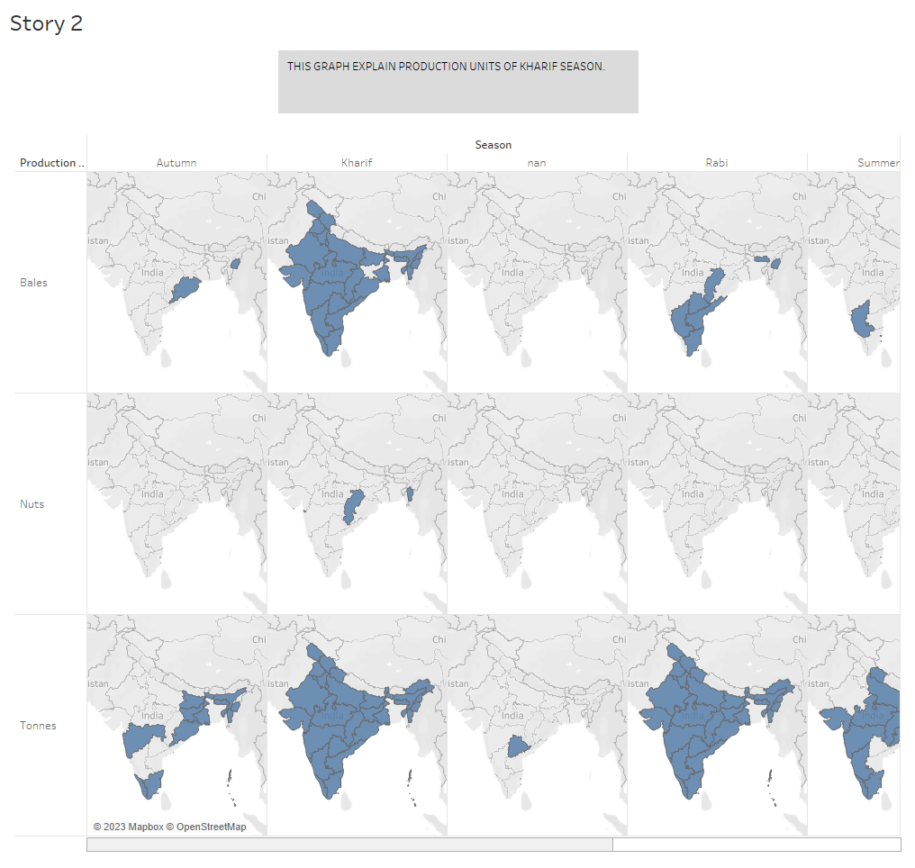
S T O R Y

Slide 13
C O N C L U S I O N
The agricultural sector is of vital importance for the region. It is undergoing a process of transition to a market economy, with substantial changes in the social, legal, structural, productive and supply set-ups, as is the case with all other sectors of the economy. These changes have been accompanied by a decline in agricultural production for most countries, and have affected also the national seed supply sectors of the region.
Indian economy as it contributes about 17% to the total GDP and provides employment to over 60% of the population.
In future our government try to increase the agricultural participants in GDP….

